Slide 1
Pharmacogenetics & pharmacogenomics

Slide 2
Objectives
What is pharmacogenetics (pharmacogenomics)?
Importance of pharmacogenetics
Define genetic polymorphism
Types of genetic polymorphism
Polymorphism affecting pharmacokinetics
Polymorphism affecting pharmacodynamics
Polymorphism affecting underlying disease and adverse drug reactions

Slide 3
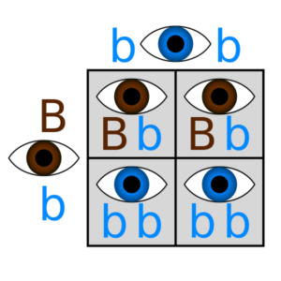
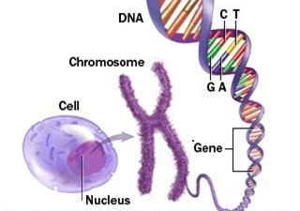
Concepts: gene, chromosome, genotype and phenotype

Slide 4
Pharmacogenomics & Pharmacogenetics
Genomics: The study of genetic material found in a cell (DNA)
Pharmacogenomics: is a branch of pharmacology concerned with using DNA data to explain individual variations in drug response.
Pharmacogenetics: The study or clinical testing of genetic variation affecting individual patients different response to drugs
Goal:
  To develop precisely targeted, optimal drug therapy (personalized medicine)
  Minimizing drug related adverse effects
  Personalized medicine: the tailoring of medical treatment to the specific characteristics of each patient. ( right patient, right drug, right dose)

Slide 5
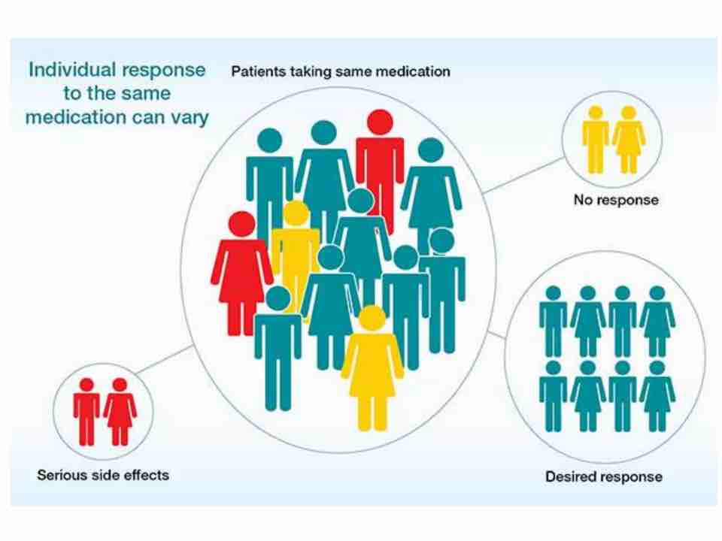

Slide 6
Genetic polymorphism
Variations in human genome that occurs in 1% of population
Types of genetic polymorphism:
  Single nucleotide polymorphisms (SNPs)
  Indel (insertion-deletion)

Slide 7
Single nucleotide polymorphisms (SNPs)
The most common variation in human DNA
Each SNP represents a difference in a single DNA building block, called a nucleotide
Example: the substitution of a C for a G in the nucleotide sequence AACGAT, thereby producing the sequence AACCAT.
SNPs in non-coding regions can manifest in a higher risk of cancer
SNPs in coding regions:
Silent substitutions do not result in a change of amino acid sequence (silent mutation)
Non-silent substitutions
Missense: single change in the base results in change in amino acid of protein and its malfunction which leads to disease
Nonsense: mutation in a sequence of DNA that results in a nonsense codon in the transcribed mRNA, nonfunctional protein product (e.g. Cystic fibrosis mutation in the cystic fibrosis transmembrane conductance regulator gene).

Slide 8
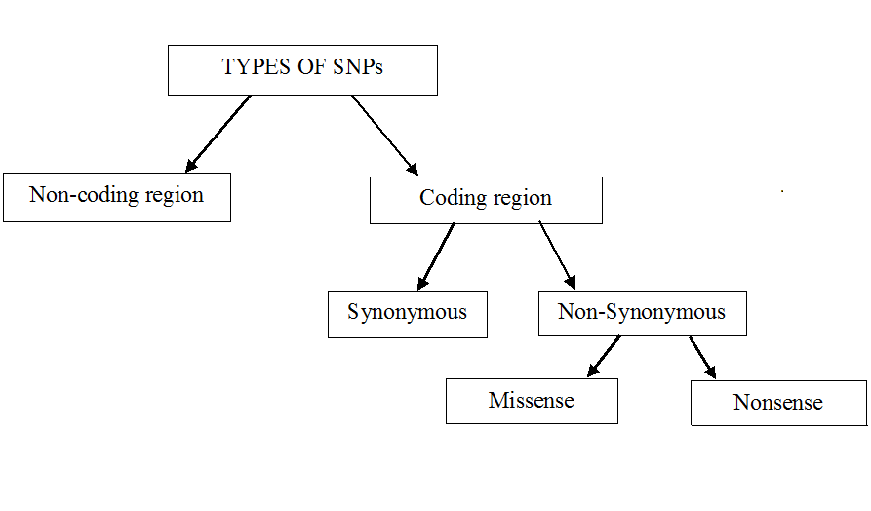
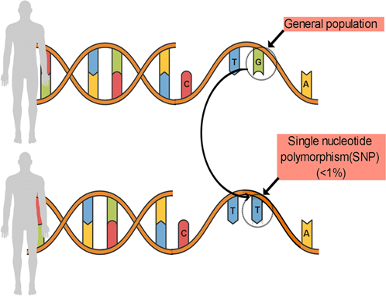
Types of SNPs

Slide 9
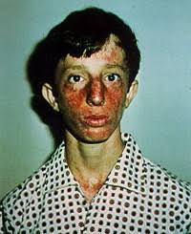
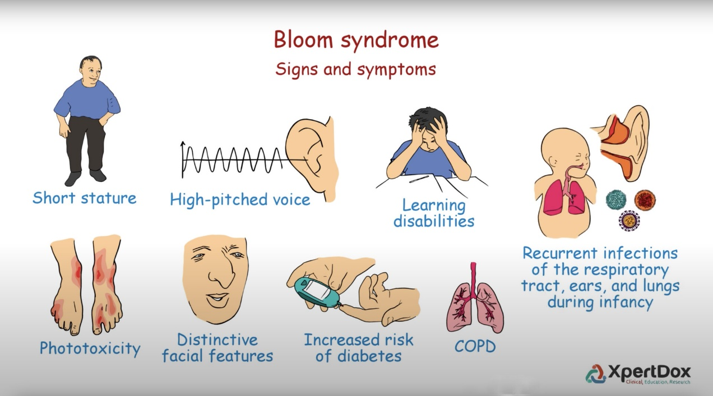
Indel (insertion-deletion)
an insertion or deletion of bases in the genome of an organism
Example:
  Causes Bloom syndrome in the Jewish or Japanese population.

Slide 10
Pharmacogenomic Polymorphism
Affected genes lead to different phenotypes with modified response and adverse effects to certain drugs:
  Pharmacokinetic polymorphism
  Pharmacodynamics polymorphism
  Polymorphism modifying underlying disease

Slide 11
Polymorphisms modifying PKs
Cytochromes P450 (P450s or CYPs) are a family of enzymes
Mainly found within the endoplasmic reticulum and mitochondria of liver cells.
They are also found in many other cells of the body.
These membrane-bound proteins are involved in the metabolism of many harmful substrates, such as toxins.
Of all the different CYP proteins that are present in the human body, 6 of them are involved in the metabolism of 90% of drugs.
The most important are CYP3A4, CYP2C9, CYP2C19 and CYP2D6.
Changes in genes controlling CYP enzymes can make them: more active or less active than normal, or completely inactive

Slide 12
Examples of pharmacokinetic polymorphism
Clopedogril (anticoagulant, inhibiting platelet aggregation): 85% metabolized by an esterase to inactive metabolite and 15% metabolized by CYP2C19 to active metabolite.
CYP2C19 poor phenotype: poor anticoagulant action of clopedogril: blood clotting
Antidepressants: metabolized by: CYP2D6:
Poor phenotype: increased antidepressant toxicity
Ultra-rapid phenotype: decreased efficacy

Slide 13
Succinylcholine (scoline) apnea
SCH is rapidly hydrolyzed by butyrylcholinesterase (BCHE, also known as plasma cholinesterase and pseudocholinesterase), which is synthesized in the liver and present in plasma (duration of action: 5 min).
Succinylcholine or scoline apnoea, occurs when there are abnormalities in plasma cholinesterase and the body has difficulties in metabolizing the drug leading to prolonged muscle paralysis and respiratory failure ( death).
Treatment?

Slide 14
Rapid and slow acetylators of INH
The rate of drug acetylation is influenced by genetic factors (hepatic acetyltransferase gene).
Hepatic acetyltransferase metabolizes INH
Individuals who are phenotypically slow acetylators are have a higher risk of hepatotoxicity than do rapid acetylators

Slide 15
Polymorphisms modifying PDs
Beta-Adrenergic Receptors Gene Polymorphisms alter response to bronchodilators
Serotonine receptor gene polymorphisms affect response to antidepressant drugs

Slide 16
Polymorphisms modifying diseases and drug responses
G6PD deficiency (Fauvism)
Genetic disorder that causes G6PD deficiency
More in males
G6PD protect RBCs against oxidizing agents: antibiotics, antimalarial drugs (chloroquine), aspirin, some anti-cancer medicines and large doses of vitamin C, some foods, particularly fava beans, certain infections
These agents destroy RBCs causing hemolysis and anemia which can be life-threatening.

Slide 17
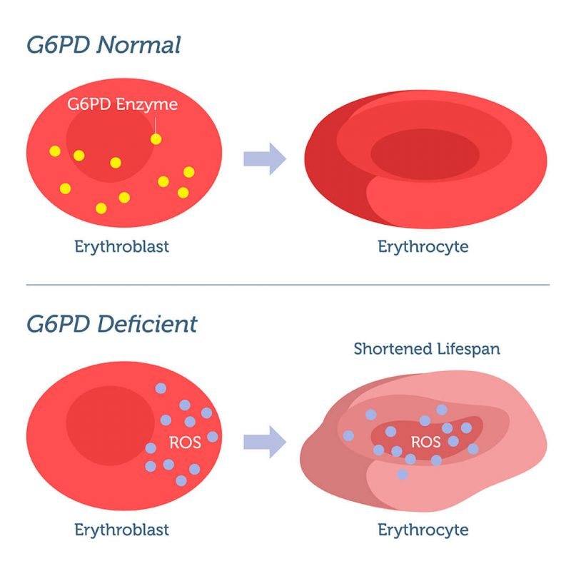
G6PD deficiency (Fauvism)

Slide 18
Malignant hyperthermia (MH)
MH is a type of severe reaction that occurs in response to particular medications used during general anesthesia (volatile anesthetic agents and succinylcholine) in susceptible individuals.
Symptoms include muscle rigidity, fever, and tachycardia
Complications can include muscle breakdown and high blood potassium
Due to genetic mutations in RYR1 gene
  Ryanodine receptor 1 (RYR1): functions as calcium release channel in the sarcoplasmic reticulum
In susceptible individuals, the medications induce the release of stored calcium ions within muscle cells.
The resulting increase in calcium concentrations within the cells cause the muscle fibers to contract.
This generates excessive heat and results in metabolic acidosis
Treatment???

Slide 19
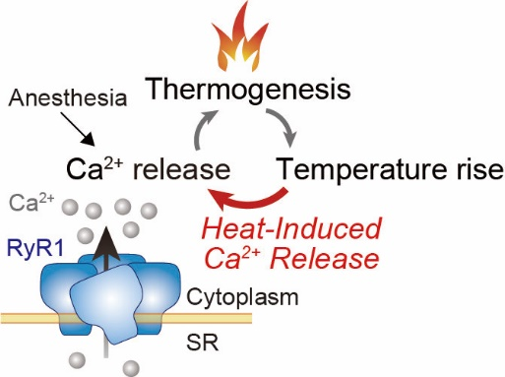
Malignant hyperthermia
Dantrolene is currently the only specific medication used for treating a malignant hyperthermia crisis
Mechanism of action:
  Antagonizing the ryanodine receptors, which lessens the excitation-contraction coupling of muscle cells.

