Slide 1
Urinary Tract Infection
Dr. Fadi Sawaqed
Presented by :
Monther Al-Qatawneh
Amin Al-Qatawneh

Slide 2
Table of contants :
01
02
03
Introduction
Epidemiology
Pathogenesis
04
05
Causative Pathogen
Diagnosis
06
07
Antibiotics
Specific Infections

Slide 3
Introduction
01
Urinary tract infection (UTI) is a term that is applied to a variety of clinical conditions ranging from localized infection of the bladder with lower urinary tract symptoms to pyelonephritis with severe infection of the kidney and the potential for resultant urosepsis.
Accurate diagnosis and treatment of a UTI is essential to limit its associated morbidity and mortality and avoid prolonged or unnecessary use of antibiotics.
Unfortunately, because of the increasing rates of bacterial resistance to various antibiotics, medical therapies are becoming less efficacious

Slide 4
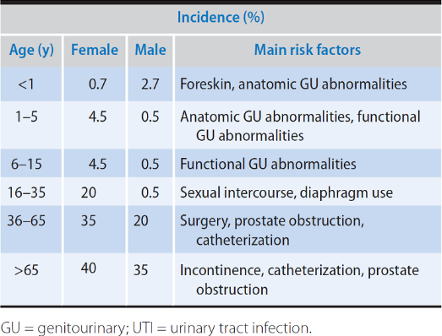
Epidemiology
02
In the neonatal period males are twice as likely as females to experience a UTI.
From ages 1 to 6 months the rate of UTI is equal between genders, but from 6 to 12 months of age the rate of UTI in male and female children is 1 to 4.
Overall, UTIs are more common in females
The incidence of UTI in uncircumcised males is 85% higher than circumcised males
Epidemiology of UTI by age, group, and sex

Slide 5
Epidemiology
Risk factors for UTI include:
Circumcision status.
History of prior UTI.
Sexual activity among older populations.
Anatomical abnormalities like vesicoureteral reflux, ureterocele, ureteropelvic junction obstruction & posterior urethral valves.
Functional abnormalities : neurogenic bladder, and bladder and bowel dysfunction
Certain medical conditions like diabetes. obesity. sickle cell trait.

Slide 6
Pathogenesis
03
Understanding of:
The mode of bacterial entry,
Host susceptibility factors,
Bacterial pathogenic factors
Are essential to tailoring appropriate treatment for the diverse clinical manifestations of UTI.

Slide 7
01
Bacterial Entry
Pathogenesis
the site through which micro-organisms
enter the susceptible host

Slide 8
Bacterial Entry
Pathogenesis
It is generally accepted that periurethral bacteria with a uropathogen from the gut ascending into the urinary tract causes most UTI.
The colonization of the urethra and migration to the bladder leads to invasion of the bladder mediated by pili and adhesions factors.
Most cases of pyelonephritis are caused by the ascent of bacteria from the bladder, through the ureter, and into the renal parenchyma.
Consequently, the short nature of the female urethra combined with its close proximity to the vaginal vestibule and rectum likely predisposes women to more frequent UTls than men

Slide 9
Bacterial Entry
Pathogenesis
Other modes of bacterial entry are uncommon causes of UTI.
I- Hematogenous spread can occur in immunocompromised patients and in neonates. Staphylococcus aureus, Candida species, and Mycobaeterium tuberculosis are common pathogens that travel through the blood to infect the urinary tract.
II- Lymphatogenous spread through the rectal, colonic, and periuterine lymphatics has been postulated as a cause for UTI;
III- Direct extension of bacteria from adjacent organs into the urinary tract can occur in patients with intraperitoneal abscesses or vesicointestinal or vesicovaginal fistulas.

Slide 10
02
Host Defense
Pathogenesis
The protection an organism is afforded against infections Types.

Slide 11
Host Defense
Pathogenesis
Unobstructed urinary flow with the subsequent washout of ascending bacteria is essential in preventing UTI.
In females, normal vaginal and periurethral flora contain microorganisms like lactobaeillus that help prevent uropathogenic colonization
The urine itself has specific characteristics (its osmolality, urea concentration, organic acid concentration, and pH) that inhibit bacterial growth and colonization.
It also contains factors that inhibit bacterial adherence, such as Tamm-Horsfall glvcoprotein (THG)
The epithelium lining the urinary tract not only provides a physical barrier to infection but also has the capacity to recognize bacteria in order to activate innate host defenses.
Specific serum and urinary antibodies are produced by the kidney to enhance bacterial opsonization and phagocytosis and inhibit bacterial adherence

Slide 12
03
Bacterial Pathogenic Factors
Pathogenesis

Slide 13
Bacterial Pathogenic Factors
Pathogenesis
The ability of E. coli to adhere to epithelial cells is mediated by ligands located on the tips of the bacterial fimbriae (pili).
Most uropathogenic E. coli strains produce hemolysin, which initiates tissue invasion and makes iron available for the infecting pathogens
The presence of K antigen on the invading bacteria protects them from phagocytosis by neutrophils
-Encapsulation and biofilm formation

Slide 14
Causative Pathogen
04
Most UTIs are caused by a single bacterial species. At least 80% of the uncomplicated cystitis and pyelonephritis in premenopausal women are due to E. coli.
Other less common uropathogens include Staphylococcus saprophyticus, Klebsiella. Proteus, and Enterobacter spp. and enterococci.
In hospital-acquired UTIs, a wider variety of causative organisms is found, including Pseudomonas and Staphylococcus spp.
In children, the causative bacterial spectrum is slightly different but there is still a predominance of E. coli among inpatient and outpatient populations. Enterobacter, Enterococcus, and Klebsiella species make up the remainder of common culprits of pediatric UTI.
Anaerobic bacteria, lactobacilli, corynebacteria, streptococci (not including enterococci), and Staphylococcus epidermidis are found in normal periurethral flora. They do not commonly cause UTIs in healthy individuals and are considered common urinary contaminants.

Slide 15
Diagnosis
05
Standard diagnosis of UTI is completed by urinalysis and urine culture of 100 CFU/mL (Where CFU = colony-forming units) of bacteria.
Occasionally, localization studies may be required to identify the source of the infection. Most often, the urine is obtained from a voided specimen.
An uncomplicated UTI consists of an infection in an otherwise healthy patient with normal urinary tract anatomy.
On the other hand, a complicated UTI can occur when anatomic abnormalities, immunocompromised state, or multi-drug-resistant bacteria allow for increased bacterial colonization or decreased therapeutic efficacy.

Slide 16
Urine Analysis
Diagnosis
The urine can be immediately evaluated for leukocyte esterase, a compound produced by the breakdown of white blood cells (WBCs) in the urine and is 95% sensitive for UTI in children with symptoms.
Positive leukocyte esterase indicates the presence of 5—15 WBC per high-power field (hpl).
Urinary nitrite is produced by reduction of dietary nitrates by many Gram-negative bacteria.
Esterase and nitrite can be detected by a urine dipstick and are more reliable when the bacterial count is >100,000 colony-forming units (CF Us) per milliliter.
Combined positive nitrite and leukocyte esterase on urine dipstick analysis is 80—90% sensitive and 60—98% specific for UTI
Notes:
Pyuria DDx:
UTI
TB
Non bacterial inflammation (as interstitial cystitis)
Stones
Carcinoma in situ

Slide 17
Urine Analysis
Diagnosis
Microscopic examination of the urine for WBCs and bacteria is performed after centrifugation.
For children, urine concentration should be taken into consideration when diagnosing infants with UTI.
A pyuria threshold of 3 WBC/hpf in dilute urine and 6 WBC/hpf in concentrated urine is noted for a diagnosis of UTI
Notes:
Pyuria DDx:
UTI
TB
Non bacterial inflammation (as interstitial cystitis)
Stones
Carcinoma in situ

Slide 18
Urine Culture
Diagnosis
The gold standard for identification of UTI is the quantitative culture of urine for specific bacteria.
Defining the CPU/ml. that represents clinically significant infection can be difficult. It is dependent on the method of collection, the sex of the patient, and the type of bacteria isolated.
Traditionally, cultures demonstrating 100,000 CPU/ml. are considered diagnostic of a UTI, but now AAP guidelines suggest pyuria and 50,000 CPU/ml. of a single organism are diagnostic of UTI

Slide 19
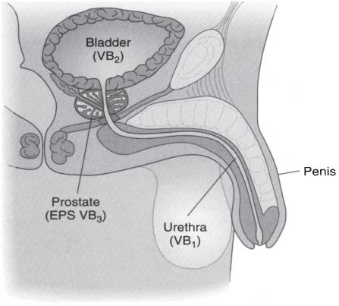
Localization Studies
Diagnosis
Occasionally, it is necessary to localize the site of infection.
For upper urinary tract localization, the bladder is irrigated with sterile water and a ureteral catheter is placed into each ureter.
A specimen is collected from the renal pelvis. Culture of this specimen will indicate whether infection in the upper urinary tract is present.
In men, infection in the lower urinary tract can be differentiated (Figure).
A specimen is collected at the beginning of the void and represents possible infection in the urethra (VB1). Next, a midstream specimen (VB2) is collected and represents possible infection in the bladder. The prostate is then massaged and the patient is asked to void again (VB3), this specimen represents possible infection of the prostate.

Slide 20
Antibiotics
06
The goal in treatment is to eradicate the infection by selecting the appropriate antibiotics that would target specific bacterial susceptibility.
The general principles for selecting the appropriate antibiotics include:
  Consideration of the infecting pathogen (antibiotic susceptibility, single-organism vs polyorganism infection, pathogen vs normal flora, community vs hospital-acquired infection);
  The patient (allergies, underlying diseases, age, previous antibiotic therapy, other medications currently taken, outpatient vs inpatient status, pregnancy);
  The site of infection (kidney vs bladder vs prostate)

Slide 21
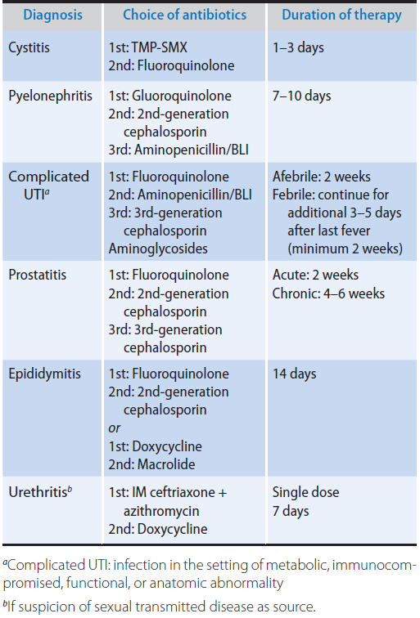
Antibiotics
Recommended antimicrobial agents and duration of therapy based upon the type of UTI for adults.
Trimethoprim—Sulfamethoxazole
Fluoroquinolones
Nitrofurantoin
Aminoglycosides
Cephalosporins
* See notes below !!
Notes:
Trimethoprim–Sulfamethoxazole
Trimethoprim–sulfamethoxazole (TMP-SMX) is commonly used to treat many UTIs, except those caused by Enterococcus and Pseudomonas spp. It interferes with the bacterial metabolism of folate.
Adverse reactions occur in 6–8% of patients using this medication; they include hypersensitivity reactions, rashes, gastrointestinal upset, leukopenia, thrombocytopenia, and photosensitivity. TMP-SMX should not be used in patients who have a folic acid deficiency state, glucose- 6-phosphate dehydrogenase deficiency, or acquired immunodeficiency syndrome (AIDS), or in pregnant patients.
Fluoroquinolones
Fluoroquinolones have a broad spectrum of activity, especially against Gram-negative bacteria. Although they have adequate activity against Staphylococci species, fluoroquinolones do not have good activity against Streptococci species and anaerobic bacteria. They interfere with the bacterial DNA gyrase, preventing bacterial replication.
Adverse reactions are infrequent and include mild gastrointestinal effects, dizziness, and lightheadedness. Fluoroquinolones should not be used in patients who are pregnant and should be used judiciously in children because of potential damage to developing cartilage.
Nitrofurantoin
Nitrofurantoin has good activity against most Gram-negative bacteria (except for Pseudomonas and Proteus spp.), Staphylococci, and Enterococci species. It inhibits bacterial enzymes and DNA activity.
It should not be used in patients with renal impairment as the drug may not reach adequate concentrations in the urine and, thus, it is not recommended in patients with a creatinine clearance below 30 mL/min. Adverse reactions are relatively common and include gastrointestinal upset, peripheral polyneuropathy, and hepatotoxicity. Long-term use may result in pulmonary hypersensitivity reaction and interstitial changes. In addition, it should
be used with caution in elderly patients. Nitrofurantoin becomes highly concentrated in the urine but demonstrates poor tissue penetration. For this reason, it should not be used for complicated UTI, pyelonephritis, or prostatitis.
Aminoglycosides
Aminoglycosides are commonly used in the treatment of complicated UTI. They are highly effective against most Gram-negative bacteria. When combined with ampicillin, they are effective against enterococci. They inhibit bacterial DNA and RNA synthesis. The principal adverse effects of aminoglycosides are nephrotoxicity and ototoxicity.
Cephalosporins
Cephalosporins have good activity against most uropathogens. First-generation cephalosporins have good activity against Gram-positive bacteria, E. coli, and Proteus and Klebsiella spp. Second-generation cephalosporins have increased activity against anaerobes and Haemophilus influenzae. Third-and fourth-generation cephalosporins have broader coverage against Gram-negative bacteria but less against Gram-positive bacteria.
The cephalosporins inhibit bacterial cell wall synthesis. Adverse reactions include hypersensitivity and gastrointestinal upset.

Slide 22
Specific Infections
06
Acute Pyelonephritis
Emphysematous Pyelonephritis
Renal Abscesses
Xanthogranulomatous Pyelonephritis
Acute Cystitis
Acute Bacterial Prostatitis

Slide 23
Acute Pyelonephritis
Specific Infections
Inflammation of the kidney and renal pelvis, and its diagnosis is usually made clinically.
Present with chills, fever, and costovertebral angle tenderness.
Accompanying lower tract symptoms such as dysuria, frequency, and urgency.
Sepsis may occur, with 20—30% of all systemic sepsis resulting from a urine infection.
Urinalysis commonly demonstrates the presence of WBCs and red blood cells in the urine.
Leukocytosis, increased erythrocyte sedimentation, and elevated levels of C-reactive protein are commonly seen on blood analysis.
Bacteria are cultured from the urine , when the culture is obtained before antibiotic treatment is instituted. E.coli is the most common causative organism, accounting for 70-80% of the cases.

Slide 24
Acute Pyelonephritis
Specific Infections
Management:
The management of acute pyelonephritis depends on the severity of the infection. In patients who have toxicity due to associated septicemia, hospitalization is warranted. Approximately 10-30% of all adult patients with acute pyelonephritis require hospitalization.
Empiric therapy with intravenous ampicillin and aminoglycosides. Alternatively. amoxicillin with clavulanic acid or a third-generation cephalosporin can be used.
For adults, fluoroquinolones or TMP-SMX is well tolerated and effective.
Outpatient treatment with an initial parental antibiotic (ceftriaxone or gentamicin) followed by oral therapy for 7—14 days
If bacteremia is present, parenteral therapy should be administered for 7—10 days and then the patient should be switched to oral treatment for an additional10-14 days.
Pregnant patient with concerns for pyelonephritis requires admission with parental antibiotics secondary to the risk of preterm labor.

Slide 25
Emphysematous Pyelonephritis
Specific Infections
Emphysematous pyelonephritis is a necrotizing infection characterized by the presence of gas within the renal parenchyma or perinephric tissue.
About 95% of patients with emphysematous pyelonephritis have diabetes;
women experience this condition 6 times more commonly than men.
Other contributing factors include renal failure, immunosuppression, obstructed upper tracts, and polycystic kidneys.
Fever, flank pain, and vomiting that fails initial management with parentera. antibiotics
Pneumaturia may be present.
Bacteria most frequently cultured from the urine include E. coli (66%); Klebsiella pneumonia (26%): and Proteus. Pseudomonas, and Streptococcus spp.

Slide 26
Emphysematous Pyelonephritis
Specific Infections
The diagnosis of emphysematous pyelonephritis is made after radiographic examination.
Gas overlying the affected kidney may be seen on a plain abdominal radiograph (kidneys, ureters, bladder [KUB]).
CT scan is much more sensitive in detecting the presence of gas in the renal parenchyma than renal ultrasonography.
In the management of emphysematous pyelonephritis, prompt control of blood glucose and relief of urinary obstruction are essential, in addition to fluid resuscitation and parenteral antibiotics

Slide 27
Renal Abscesses
Specific Infections
Renal abscesses result from a severe infection that leads to liquefaction of renal tissue; this area is subsequently sequestered, forming an abscess. They can rupture out into the perinephric space, forming perinephric abscesses. When the abscesses extend beyond the Gerota’s fascia, paranephric abscesses develop.
Hematogenous spread of staphylococci, particularly from infected skin lesions. Patients with diabetes, those undergoing hemodialysis, or intravenous drug abusers have been at high risk for developing renal abscesses.
Fever, flank or abdominal pain. chills, and dysuria. Many of the symptoms have lasted for more than 2 weeks

Slide 28
Xanthogranulomatous Pyelonephritis
Specific Infections
Chronic bacterial infection of the kidney. unilaterally. The affected kidney is almost always hydronephrotic and obstructed
Severe inflammation and necrosis obliterate the kidney parenchyma- Characteristically foamy lipid-laden histiocytes
(xanthoma cells) are present and may be mistaken for renal clear cell carcinoma
Flank pain. fever, chills. and persistent bacteriuria. A history of urolithiasis is present in about 35% of patients
Flank mass can often be palpated. Urinalysis commonly demonstrates leukocytes, bacteria. and proteinuria. Serum blood reveals anemia and may show hepatic dysfunction in approximately 50% of the patients

Slide 29
Xanthogranulomatous Pyelonephritis
Specific Infections
E. coli or Proteus species are commonly cultured from the urine.
Computed tomography scan is the most reliable method in imaging patients suspected of having XGP. It usually demonstrates a large, heterogeneous, nonenhancing reniform mass.
On contrast-enhanced images, these lesions will have a prominent blush peripherally, while the central areas, which are filled with pus and debris, do not enhance.
In some cases, XGP is misdiagnosed as a renal tumor and a nephrectomy is performed and a diagnosis is made pathologically.
In those in whom a diagnosis of XGP is suspected, kidney-sparing surgery such as a partial nephrectomy is indicated in focal disease. However, when the infection is diffuse, a nephrectomy with excision of all involved tissue is warranted.

Slide 30
Acute Cystitis
Specific Infections
Urinary infection of the lower urinary tract, principally the bladder.
Acute cystitis more commonly affects women than men.
The primary mode of infection is ascending from the periurethral/vaginal and fecal flora.
The diagnosis is made clinical.
Present with irritative voiding symptoms such as dysuria, frequency, and urgency.
Low back and suprapubic pain, hematuria, and cloudy/fouI-smelling urine are also common symptoms. Fever and systemic symptoms are rare.

Slide 31
Acute Bacterial Prostatitis
Specific Infections
Inflammation of the prostate associated with a UTI- It is believed that infection results from ascending urethral infection or reflux of infected urine from the bladder into the prostatic ducts.
Uncommon in prepubertal boys but frequently affects adult men/
It is the most common urologic diagnosis in men younger than 50 years and third most common in men older than 50 years
Present with an abrupt onset of constitutional (fever, chills, malaise, arthralgia, myalgia, lower back/rectal/perineal pain) and urinary symptoms (frequency, urgency, dysuria). They may also present with urinary retention due to swelling of the prostate.
Digital rectal examination reveals a tender, enlarged gland that is irregular and warm.

Slide 32
Acute Bacterial Prostatitis
Specific Infections
Urinalysis usually demonstrates WBCs and occasionally hematuria.
Serum blood analysis typically demonstrates leukocytosis.
Prostate-specific antigen levels are often elevated.
Empiric therapy directed against Gram-negative bacteria and enterococci should be instituted immediately while awaiting the culture results- Trimethoprim and fluoroquinolones have high drug penetration into prostatic tissue and are recommended for 4-6 weeks.
Patients who have sepsis, are immunocompromised or in acute urinary retention, or have significant medical comorbidities would benefit from hospitalization and treatment with parenteral antibiotics.
Patients with urinary retention secondary to acute prostatitis should be managed with a suprapubic catheter because transurethral catheterization or instrumentation is contraindicated.

Slide 33
Thank
You
Any questions?

